Slide 1

Ruby on Rails

Slide 2
About today…
Ruby on Rails
JavaScript

Slide 3
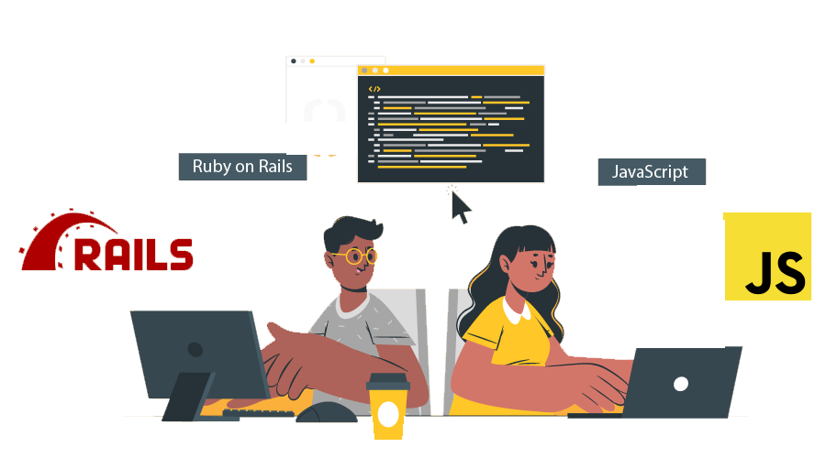
Enhance UX with JavaScript
JavaScript plays a crucial role in enhancing user experience (UX) by adding interactivity and dynamic behavior to web pages

Slide 4
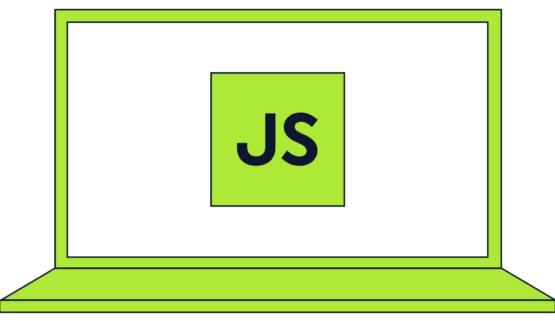
Why JavaScript in Rails?
Interactivity
Make your web pages responsive to user actions without reloading
Dynamic Updates
Update content dynamically based on user input or server responses
Enhanced Forms
Validate forms in real-time for better user feedback

Slide 5

Improving UX with JavaScript
Few other practical uses in Rails
Form Validation
Validate form fields before submission
AJAX Requests
Fetch data from the server asynchronously
Dynamic Updates
Update parts of the page without full reloads (e.g., comments, likes)

Slide 6


Getting Started
Configure Import Map
Rails 7 introduced import maps to manage JavaScript modules
Configure your import map in config/importmap.rb

Slide 7

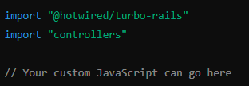

Including JavaScript in Rails
Create JavaScript File
Place your JavaScript files in app/javascript/
app/javascript/application.js
Link JavaScript in Layout
Ensure your layout file includes the JavaScript import
app/views/layouts/application.html.erb

Slide 8

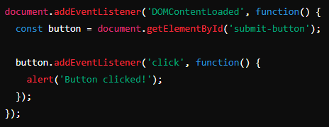
Basic JavaScript Example
app/javascript/application.js
Adds an event listener to a button with id submit-button
Displays an alert when the button is clicked

Slide 9
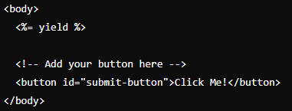

Adding the Button to the View
Add the button element in your view file where you want the button to appear
app/views/layouts/application.html.erb
Displays an alert when the button is clicked

Slide 10

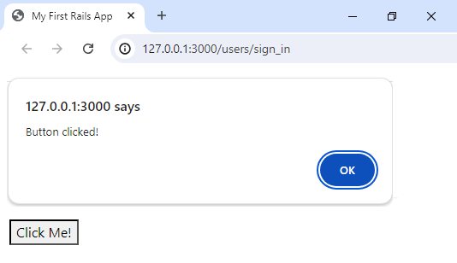

Slide 11

‘application.html.erb’ defines the basic HTML structure for your entire application
Any specific view is automatically inserted into the <%= yield %> tag in ‘application.html.erb’
Including JavaScript imports (<%= javascript_importmap_tags %>) in ‘application.html.erb’ ensure that these scripts are included on every page of your application
‘application.html.erb’ acts as a master template for application, providing consistent look across all pages
Any JavaScript code placed in app/javascript/application.js will be available throughout application because it's linked from ‘application.html.erb’

Slide 12


Slide 13


What is the purpose of the import map feature introduced in Rails 7?
To manage JavaScript modules
Where should you place your custom JavaScript files in a Rails 7 application?
app/javascript/
Which Rails helper method should you use to include the JavaScript import map in your layout file?
<%= javascript_importmap_tags %>
What event does the following JavaScript code snippet listen for?
DOMContentLoaded

Slide 14

Task 1
Add JavaScript in your code in such a way that it alerts welcome message when app is launched for the first time

